Slide 1
Von Neumann Model
Chapter 4

Slide 2
Outline
Basic Components
Memory, Processing Unit, Input & Output, Control Unit
LC-3: An Example von Neumann Machine
Instruction Processing
The Instruction, The Instruction Cycle
Fetch, Decode, Evaluate Address, Fetch Operands, Execute, Store Result
Changing the Sequence of Execution
Stopping the Computer

Slide 3
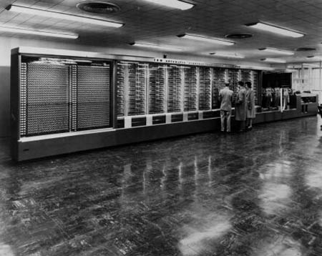
Harvard Mark I

Slide 4
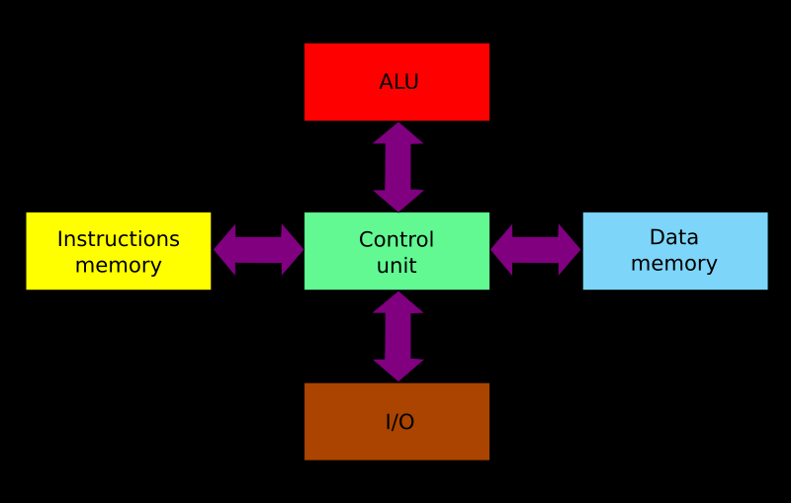
Harvard Model

Slide 5
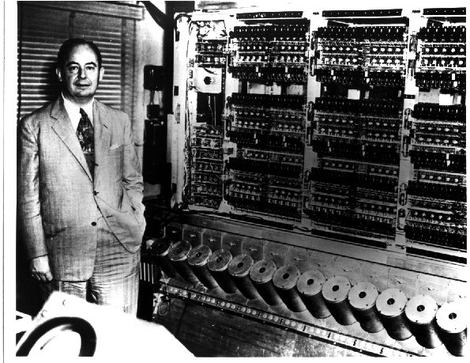
John von Neumann & EDVAC
Electronic Discrete Variable Automatic Computer

Slide 6
First Draft of a Report on the EDVAC by John von Neumann, Contract No. W-670-ORD-4926, Between the United States Army Ordnance Department and the University of Pennsylvania Moore School of Electrical Engineering University of Pennsylvania June 30, 1945

Slide 7
von Neumann Model
CONTROL
PROCESSOR
MEMORY
INPUT
OUTPUT

Slide 8
The Idea
The central idea in the von Neumann model of computer processing is that the program and data are both stored as sequences of bits in the computer's memory, and the program is executed, one instruction at a time, under the direction of the control unit.

Slide 9
Splitting Hairs...
There is also a class of architectures called “Modified Harvard Architecture”
These are systems that may treat memory as a single address space, but provide different paths to the CPU for instructions and data, typically to improve performance
That tells us that, just like much of the rest of computer architecture, there is a spectrum of possible architectures between Harvard and von Neumann
Don’t let that worry you

Slide 10
Some Stats
Harvard Mark I
Switches, relays, rotating shafts, clutches
60 sets of 24 decimal switches
72 adding machines with 23 decimal digits
Instructions stored on paper tape loop
3.7 kW electric motor(!)
3 additions/sec, 6 sec/multiplication
EDVAC
6,000 vacuum tubes, 12,000 diodes
Magnetic tape input/output
1000 44-bit words in 128 acoustic delay lines
56 kW power
1160 additions/second, 340 multiplications/sec

Slide 11
Machine Instructions as Data?
The von Neumann model leads us to treat machine instructions as just another data representation!
Think unsigned integer, twos-complement integer, ASCII, IEEE-754 floating point, ..., and machine instructions

Slide 12
Memory
What is stored in memory?
How many memories do we need?

Slide 13
Memory
16
IN
ADDR
DATA IN
OUT
MAR
MDR
OUT
WE
DATA OUT
IN
MUX

Slide 14
von Neumann Model
CONTROL
PROCESSOR
MEMORY
INPUT
OUTPUT
MDR
MAR

Slide 15
gatePC
16
Control
DR
3
REG
FILE
SR2 SR1
OUT OUT
LD.PC
PC
PCMUX
+1
2
LD.REG
PCMUX
16
SR2
3
3
SR1
16
16
16
FINITE
STATE
MACHINE
SR2MUX
Processor
2
B
A
R
ALU
LD.IR
IR
16
gateALU
16
16
GateMDR
16
INPUT
OUTPUT
16
KBDR
DDR
LD.MDR
MDR
MEMORY
MAR
LD.MAR
KBSR
DSR
MEM.EN, R.W

Slide 16
Situational Awareness
Knowing Where Things Are

Slide 17
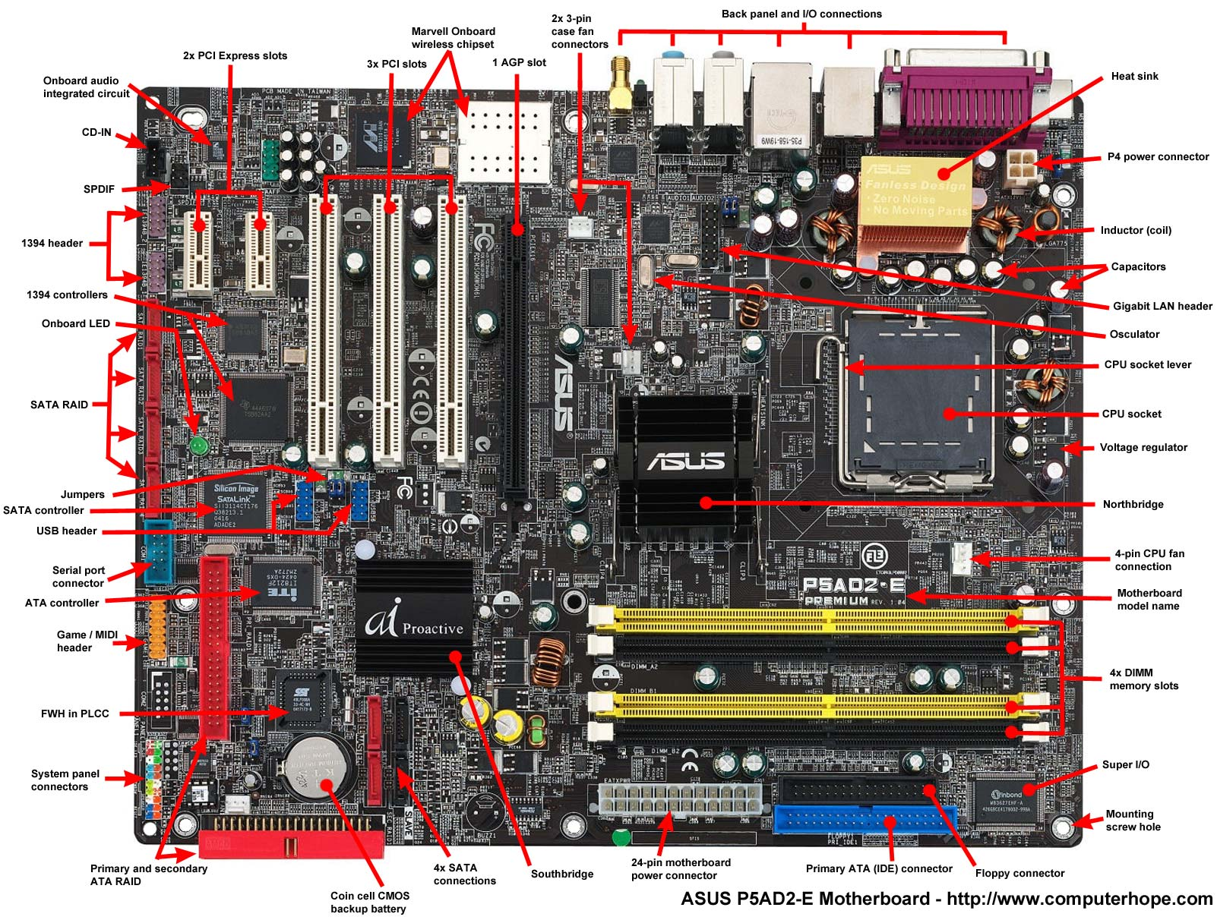

Slide 18
Issues
Memory
MAR, MDR
Processing Unit
Register File, ALU (size)
Input and Output
KBDR, KBSR, DDR, DSR
Control
FSM, PC (Next Instruction Pointer), IR

Slide 19
What is a Machine Instruction?

Slide 20
Test Yourself
The Program Counter (PC) holds
The count of instructions executed
The address of the next instruction to be executed
The instruction currently being executed
Number of programs completed since the last boot

Slide 21
Test Yourself
The Instruction Register (IR) holds
All legal op codes
The address of the next instruction to be executed
The instruction currently being executed
All data needed to execute the current instruction

Slide 22
LC-3 CPU
Address space
2₁₆ = 65536
Addressability
16 bits
Architecture type
Von Neumann
General purpose registers
8
Instruction size
16 bits

Slide 23
LC-3 Instructions
ADD
0
0
0
1
0
0
0
0
0
0
0
0
0
0
0
0

Slide 24
ADD+
0001
DR
SR1
0
00
SR2
ADD+
0001
DR
SR1
1
imm5
AND+
0101
DR
SR1
0
00
SR2
AND+
0101
DR
SR1
1
imm5
BR
0000
n
z
p
PCoffset9
JMP
1100
000
BaseR
000000
JSR
0100
1
PCoffset11
JSRR
0100
0
00
BaseR
000000
LD+
0010
DR
PCoffset9
LDI+
1010
DR
PCoffset9
+ Indicates instructions that modify condition codes

Slide 25
Instruction Example
ADD R2,R1,R3
ADD
R2
R1
R3
0
0
0
1
0
1
0
0
0
1
0
0
0
0
1
1
0x1443
012103

Slide 26
Instruction Cycle
F
Fetch
Decode
Evaluate Address [optional]
Fetch Operands [optional]
Execute [optional]
Store Result [optional]
D
EA
OP
EX
S

Slide 27
Before We Look at the Data Path During the Instruction Cycle...
There are 39 control signals orchestrated by the FSM
The wires don’t fully show up in the datapath diagram, but the signals have names
Multiplexor selectors
PCMUX, MARMUX, ADDR2MUX, …
Tri-state buffer enables
gatePC, gateMARMUX, gateALU,…
Register write enables
LD.PC, LD.REG, LD.MAR, LD.CC, …
Others
ALUK, MEM.EN, R.W, …

Slide 28
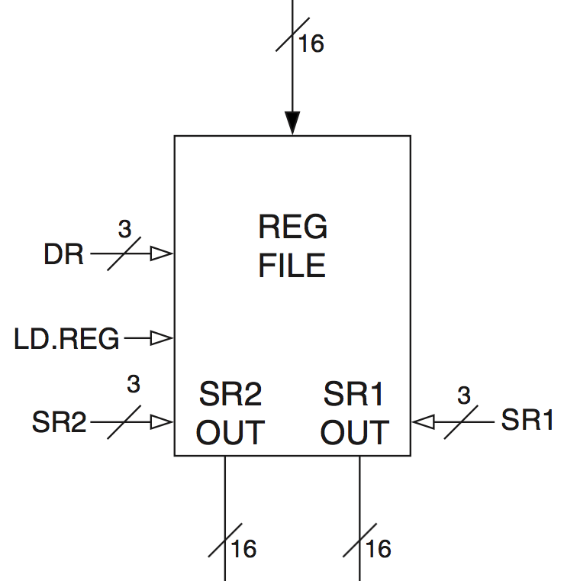
Register File Circuit
“Memory” with 8 16-bit locations
Two output controllers
SR1 (3 bits)
SR2 (3 bits)
One input controller
DR (3 bits)
LD.REG
Cycles with the CPU clock

Slide 29
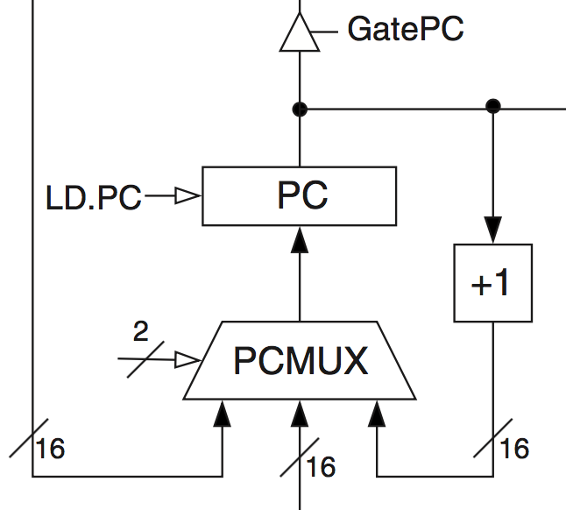
Program Counter Circuit
PCMUX
Adder to increment PC
Data from bus to PC
Data from effective address calculator to PC

Slide 30
Instruction Processing: FETCH
F
Load next instruction (at address stored in PC) from memory into Instruction Register (IR).
Copy contents of PC into MAR.
Send “read” signal to memory.
Copy contents of MDR into IR.
Increment PC, so that it points to the next instruction in sequence.
PC becomes PC+1.
D
EA
OP
EX
S

Slide 31
gatePC
16
Control
DR
3
REG
FILE
SR2 SR1
OUT OUT
LD.PC
PC
PCMUX
+1
FETCH
2
2
LD.REG
PCMUX
16
SR2
3
3
SR1
16
16
16
FINITE
STATE
MACHINE
SR2MUX
Processor
2
B
A
R
ALU
LD.IR
IR
16
gateALU
16
16
GateMDR
16
INPUT
OUTPUT
16
KBDR
DDR
LD.MDR
MDR
MEMORY
MAR
LD.MAR
KBSR
DSR
MEM.EN, R.W

Slide 32
Instruction Processing: DECODE
F
First identify the opcode.
In LC-3, this is always the first four bits of instruction.
The FSM chooses a next state corresponding to the desired opcode.
Depending on opcode, identify other operands from the remaining bits.
Example:
for LDR, last six bits is offset
for ADD, last three bits is source operand #2
D
EA
OP
EX
S

Slide 33
gatePC
16
Control
DR
3
REG
FILE
SR2 SR1
OUT OUT
LD.PC
PC
PCMUX
+1
2
LD.REG
DECODE
PCMUX
16
SR2
3
3
SR1
16
16
16
FINITE
STATE
MACHINE
SR2MUX
Processor
2
B
A
R
ALU
LD.IR
IR
16
gateALU
16
16
GateMDR
16
INPUT
OUTPUT
16
KBDR
DDR
LD.MDR
MDR
MEMORY
MAR
LD.MAR
KBSR
DSR
MEM.EN, R.W

Slide 34
Instruction Processing: EVALUATE ADDRESS
F
For instructions that require memory access, compute address used for access.
Examples:
add offset to base register (as in LDR)
add offset to PC
add offset to zero
D
EA
OP
EX
S

Slide 35
gatePC
16
Control
DR
3
REG
FILE
SR2 SR1
OUT OUT
LD.PC
PC
PCMUX
+1
2
LD.REG
PCMUX
16
SR2
3
3
SR1
EVALUATE ADDRESS
(Addresses are registers; nothing to calculate)
16
16
16
FINITE
STATE
MACHINE
SR2MUX
Processor
2
B
A
R
ALU
LD.IR
IR
16
gateALU
16
16
GateMDR
16
INPUT
OUTPUT
16
KBDR
DDR
LD.MDR
MDR
MEMORY
MAR
LD.MAR
KBSR
DSR
MEM.EN, R.W

Slide 36
Instruction Processing: FETCH OPERANDS
F
Obtain source operands from memory needed to execute the operation.
Examples:
load data from memory (LDR)
bring data from a register (unless the CPU can do that during EXECUTE like the LC-3)
D
EA
OP
EX
S

Slide 37
gatePC
16
Control
DR
3
REG
FILE
SR2 SR1
OUT OUT
LD.PC
PC
PCMUX
+1
2
LD.REG
PCMUX
16
SR2
3
3
SR1
FETCH OPERANDS
(Operands in registers; nothing to fetch)
16
16
16
FINITE
STATE
MACHINE
SR2MUX
Processor
2
B
A
R
ALU
LD.IR
IR
16
gateALU
16
16
GateMDR
16
INPUT
OUTPUT
16
KBDR
DDR
LD.MDR
MDR
MEMORY
MAR
LD.MAR
KBSR
DSR
MEM.EN, R.W

Slide 38
Instruction Processing: EXECUTE
F
Perform the operation, using the source operands.
Examples:
send operands to ALU and assert ADD control signal
do nothing (e.g., for loads and stores)
D
EA
OP
EX
S

Slide 39
gatePC
16
2
3
REG
FILE
SR2 SR1
OUT OUT
Control
LD.PC
PC
DR
PCMUX
+1
2
LD.REG
PCMUX
EXECUTE
16
3
3
3
1
SR2
SR1
16
16
16
1
FINITE
STATE
MACHINE
SR2MUX
+
Processor
2
B
A
R
0
ALU
LD.IR
IR
16
gateALU
16
16
GateMDR
16
INPUT
OUTPUT
16
KBDR
DDR
LD.MDR
MDR
MEMORY
MAR
LD.MAR
KBSR
DSR
MEM.EN, R.W

Slide 40
Instruction Processing: STORE RESULT
F
Write results to memory (or a register if the CPU doesn’t do that as part of EXECUTE)
Examples:
for store instruction, data is stored to memory
write address to MAR, data to MDR
assert WRITE signal to memory
for ADD instruction, store the result in the destination register if not done in EXECUTE
D
EA
OP
EX
S

Slide 41
gatePC
16
Control
DR
3
REG
FILE
SR2 SR1
OUT OUT
LD.PC
PC
PCMUX
+1
2
LD.REG
PCMUX
16
SR2
3
3
SR1
STORE RESULT
16
16
16
FINITE
STATE
MACHINE
SR2MUX
Processor
2
B
A
R
ALU
LD.IR
IR
16
gateALU
16
16
GateMDR
16
INPUT
OUTPUT
16
KBDR
DDR
LD.MDR
MDR
MEMORY
MAR
LD.MAR
KBSR
DSR
MEM.EN, R.W

Slide 42
Instruction Processing Summary
Instructions look just like data – it’s all interpretation.
Three basic kinds of instructions:
computational instructions (ADD, AND, …)
data movement instructions (LD, ST, …)
control instructions (JMP, BRnz, …)
Six basic phases of instruction processing: F → D → EA → OP → EX → S
not all phases are needed by every instruction
phases may take variable number of machine cycles

Slide 43
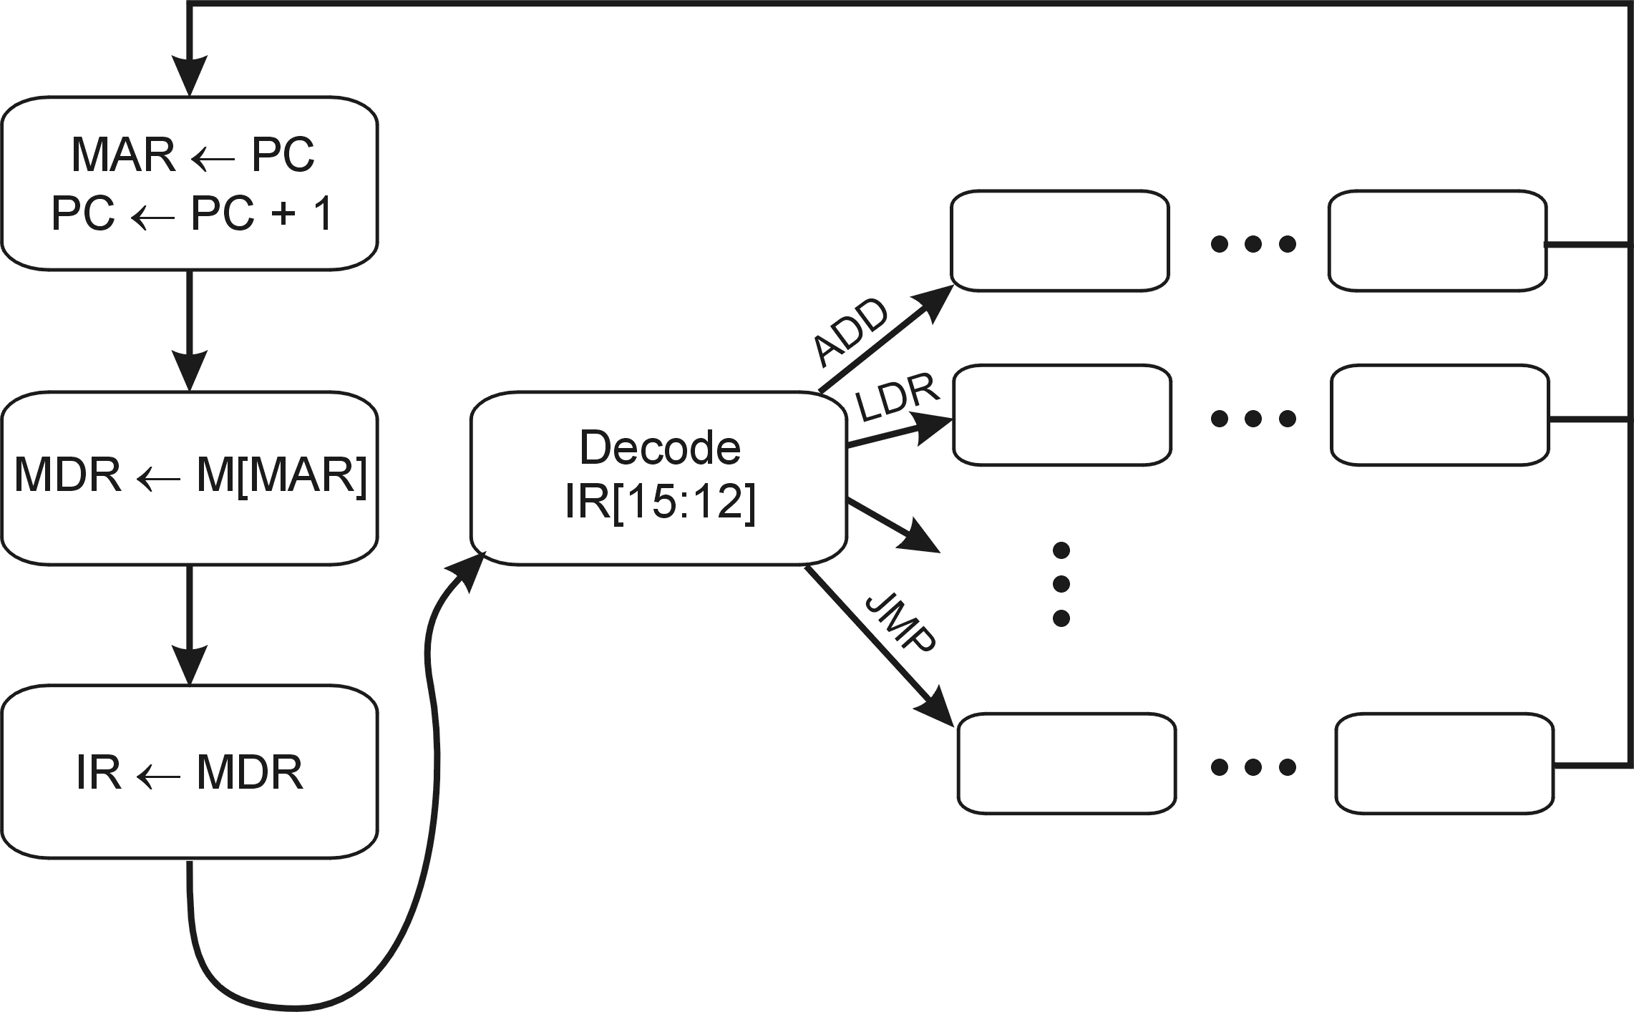
Control Unit State Diagram
The control unit is a state machine. Here is part of a simplified state diagram for the LC-3:
18
1
32
6
33
35
12
A more complete state diagram is in Appendix C.
It will be more understandable after Chapter 5.

Slide 44
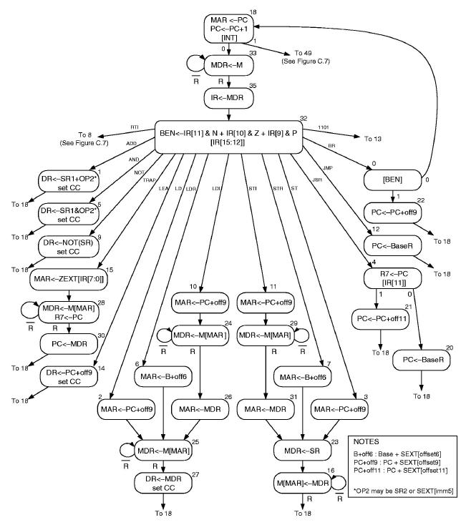
LC-3 Finite State Machine p. 568, Fig C.3

Slide 45
Changing the Sequence of Instructions
In the FETCH phase, we increment the Program Counter by 1.
What if we don’t want to execute the instruction that follows this one?
examples: loop, if-then, function call
We need special instructions that change the contents of the PC.
These are called control instructions.
jumps are unconditional -- they always change the PC
branches are conditional -- they change the PC only if some condition is true (e.g., the result of an ADD is zero)

Slide 46
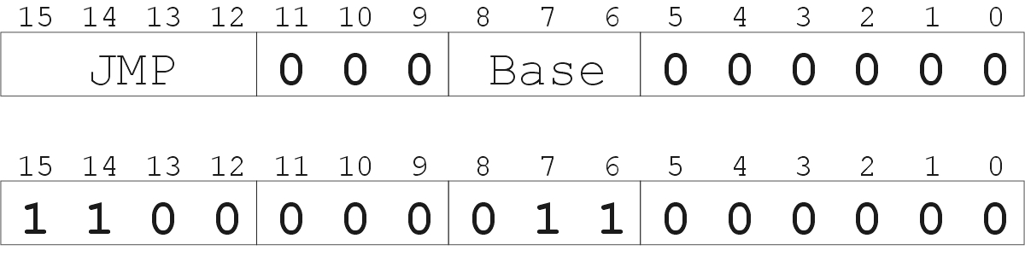
Example: LC-3 JMP Instruction
Set the PC to the value contained in a register. This becomes the address of the next instruction to fetch.
“Move the contents of R3 into the PC.”

Slide 47
gatePC
16
Control
DR
3
REG
FILE
SR2 SR1
OUT OUT
LD.PC
PC
PCMUX
+1
1
2
LD.REG
PCMUX
EXECUTE
16
3
3
3
SR2
SR1
16
16
16
FINITE
STATE
MACHINE
SR2MUX
Processor
2
B
A
R
ALU
LD.IR
IR
16
gateALU
16
16
GateMDR
16
INPUT
OUTPUT
16
KBDR
DDR
LD.MDR
MDR
MEMORY
MAR
LD.MAR
KBSR
DSR
MEM.EN, R.W

Slide 48
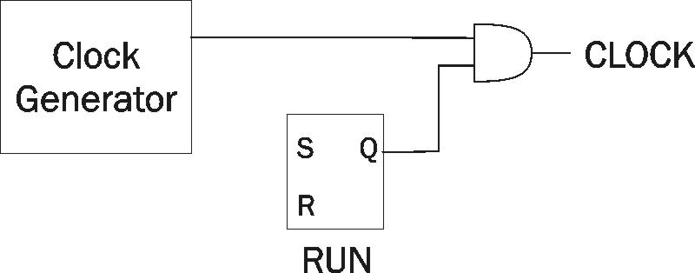
Stopping the Clock
Control unit will repeat instruction processing sequence as long as clock is running.
If not processing instructions from your application, then it is processing instructions from the Operating System (OS).
The OS is a special program that manages processor and other resources.
To stop the computer:
AND the clock generator signal with ZERO
When control unit stops seeing the CLOCK signal, it stops processing.

Slide 49
Instructions
LDR
0
1
1
0
0
0
0
0
0
0
0
0
0
0
0
0

Slide 50


Which is better?

Slide 51


Slide 52

Treasure Map

Slide 53
gateMARMUX
gatePC
16
DR
3
REG
FILE
SR2 SR1
OUT OUT
MARMUX
MARMUX
LD.PC
PC
16
PCMUX
+1
16
16
2
LD.REG
PCMUX
16
SR2
3
3
SR1
ZEXT
ADDR2MUX
+
[7:0]
2
ADDR1MUX
ADDR2MUX
ADDR1MUX
16
16
16
[10:0]
SEXT
16
16
16
16
16
0
16
[4:0]
SEXT
[8:0]
SEXT
FINITE
STATE
MACHINE
SR2MUX
[5:0]
SEXT
N
Z
P
LD.CC
B
A
2
ALU
LD.IR
IR
LOGIC
R
16
16
gateALU
16
16
GateMDR
16
16
LD.MDR
MDR
MEMORY
MAR
LD.MAR
INPUT
OUTPUT
MEM.EN, R.W

Slide 54
Flow Control
Normally we execute instructions one after another
Test Yourself
When might we not want to do this?
Tuesdays
During compilation
When branching, jumping or looping
When playing pirated games

Slide 55
Instructions
JMP
1
1
0
0
0
0
0
0
0
0
0
0
0
0
0
0

Slide 56
gateMARMUX
gatePC
16
DR
3
REG
FILE
SR2 SR1
OUT OUT
MARMUX
MARMUX
LD.PC
PC
16
PCMUX
+1
16
16
2
LD.REG
PCMUX
16
SR2
3
3
SR1
ZEXT
ADDR2MUX
+
[7:0]
2
ADDR1MUX
ADDR2MUX
ADDR1MUX
16
16
16
[10:0]
SEXT
16
16
16
16
16
0
16
[4:0]
SEXT
[8:0]
SEXT
FINITE
STATE
MACHINE
SR2MUX
[5:0]
SEXT
N
Z
P
LD.CC
B
A
2
ALU
LD.IR
IR
LOGIC
R
16
16
gateALU
16
16
GateMDR
16
16
LD.MDR
MDR
MEMORY
MAR
LD.MAR
INPUT
OUTPUT
MEM.EN, R.W

Slide 57
Stopping
Clock
S
R

Slide 58
gateMARMUX
gatePC
16
DR
3
REG
FILE
SR2 SR1
OUT OUT
MARMUX
MARMUX
LD.PC
PC
16
PCMUX
+1
16
16
2
LD.REG
PCMUX
16
SR2
3
3
SR1
ZEXT
ADDR2MUX
+
[7:0]
2
ADDR1MUX
ADDR2MUX
ADDR1MUX
16
16
16
[10:0]
SEXT
16
16
16
16
16
0
16
[4:0]
SEXT
[8:0]
SEXT
FINITE
STATE
MACHINE
SR2MUX
[5:0]
SEXT
N
Z
P
LD.CC
B
A
2
ALU
LD.IR
IR
LOGIC
R
16
16
gateALU
16
16
GateMDR
16
16
LD.MDR
MDR
MEMORY
MAR
LD.MAR
INPUT
OUTPUT
MEM.EN, R.W

Slide 59
Questions

